Slide 1
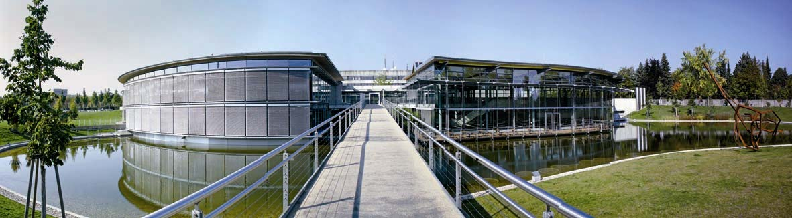
Welcome to
OTH Regensburg

Slide 2



Regensburg
WELCOME TO REGENSBURG!
Located In the east of Bavaria
UNESCO World Heritage city with 2000 years of history
Tremendous number of cafés, bars, clubs and restaurants
Christmas markets in winter, lots of festivals in summer
“Student city” (around 30.000 students from 3 universities)

Slide 3


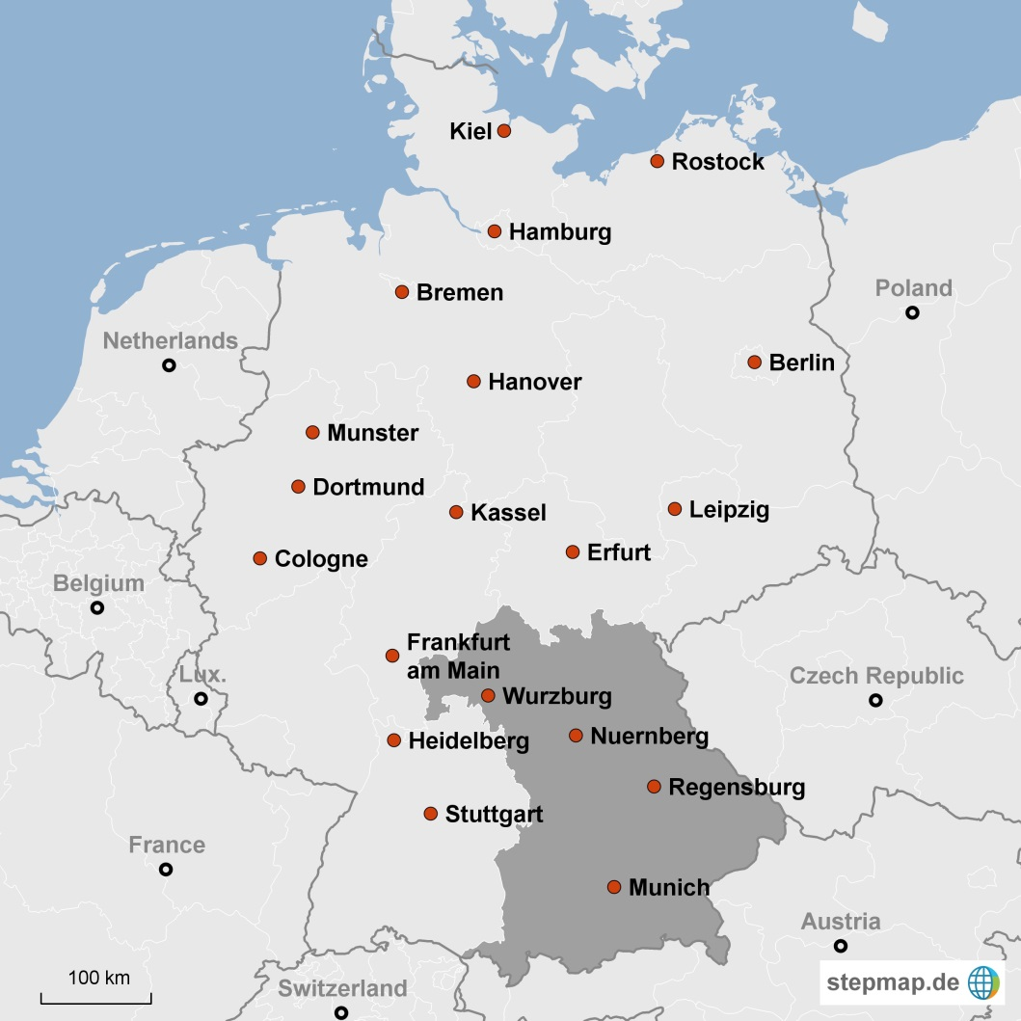

Facts about Bavaria
Known worldwide for food, sights & culture
Located in the center of the European Union, south of Germany
Population: ~13m (Germany: ~82m; Europe: ~500m)
Economic power house of Germany
- GDP: 586bn €
- Full employment
- Balanced fiscal budget
Several multi-national companies with headquarters/major subsidiaries
- Allianz
- Audi
- BMW
- Google
- Infineon
- Osram
17 Universities of Applied Sciences,
10 traditional Universities
  Linde
  Microsoft
  Munich Re
  Siemens
  Continental
p. 3

Slide 4
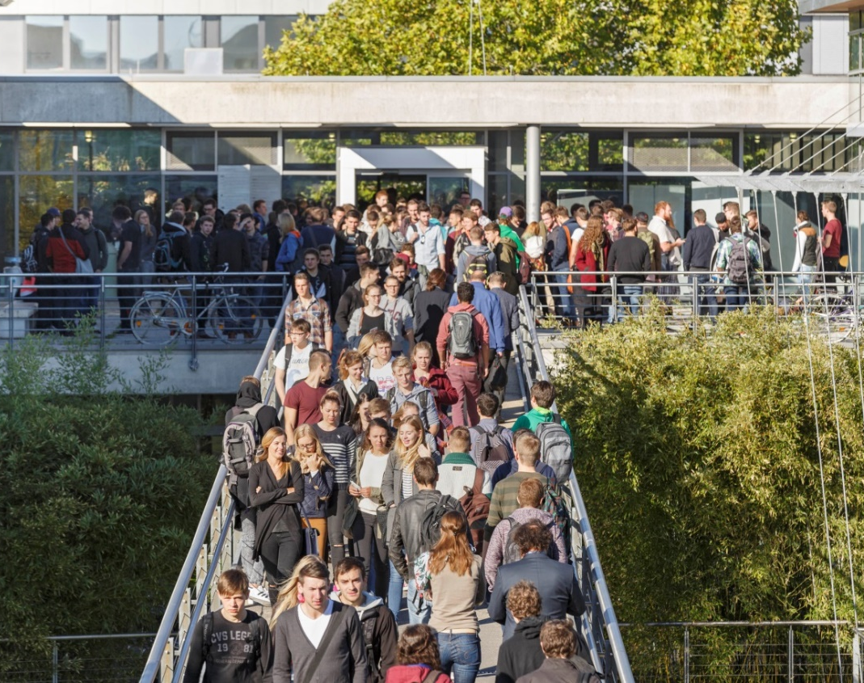
Facts and aims
OTH = East Bavarian Technical University of Applied Sciences The roots of the OTH Regensburg go back into the 19th Century Around 11.500 students Our objective in teaching to prepare the students for a (international) career typically outside of the academic sector to set a clear focus on high level application-oriented teaching to offer accredited bachelor programs, which include a compulsory practical semester

Slide 5

Teaching: 29 Bachelor and 23 Master
Degree Programmes
Bachelor
Master
Architecture
  Architecture
  Industrial Design
  Building Climate Control
Civil Engineering
Electrical Engineering and Information Technology
  Electrical Engineering and Information Technology
  Mechatronics
  Renewable Energy Engineering
  and Energy Efficiency
Computer Science and Mathematics
  Computer Science
  Business Information Technology
  Computer Engineering
  Medical Informatics
  Mathematics
Mechanical Engineering
  Mechanical Engineering
  Biomedical Engineering
  Manufacturing and Automation
  Mechatronic Systems Engineering
General Studies and Microsystems Engineering
  Sensor Technology and Analytics
  Microsystems Technology
  International Relations and Management
Business Studies
  Business Studies
  Business Studies (part-time)
  European Business Studies (with multinational degree)
Social and Health Care Sciences
  Social Work
  Music- and Movement Oriented Social Work
  Nursing Science
  Nursing Management
  Logopedics
  Physiotherapy
Architecture
  Architecture
  Building Archeology
Civil Engineering
Electrical Engineering & Information Technology
  Electromobility and Power Networks
  Applied Research in Engineering Sciences
  Automotive Electronics*
Computer Science
and Mathematics
  Computer Science
  Mathematics
Mechanical Engineering
  Industrial Engineering
  Medical Engineering
  Mechanical Engineering
General Studies and Microsystems Engineering
  Electrical and Microsystems Engineering
  Management of Intercultural Issues and Development Management
Business Studies
  Business Studies
  European Business Studies (with multinational degree)
  Human Resource Management
  Logistics
  Master of Business Administration*
Social and Health Care Sciences
  Social Work – Inclusion and Exclusion
  Advanced Nursing Practice
  Management and Communications (part-time)*
*Advanced Master´s Studies (In-service Training)

Slide 6
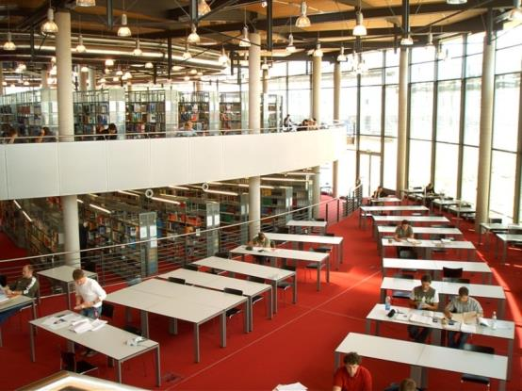

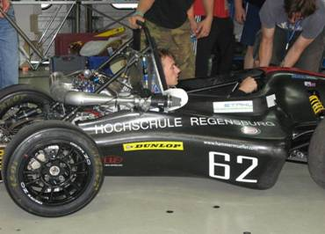
Facilities & Campus life
  Library
  Refectory and cafeterias
  Computer Centre
  Student advisory service
  Sports center (shared with University of Regensburg)
  Student clubs e.g. Formula Student (Dynamics e.V. und Regenics e.V.)
  International Office

Slide 7

International Office – Incoming Students
Exchange at OTH
  No tuition fees for students of partner universities (only bus semester ticket)
  Free German language courses (in winter semester: intensive language course before start of semester)
  Huge variety of English lectured courses (going back to on-campus lecutres)
  Exclusive courses for exchange students
  Course choice possible from every faculty
  Study guide booklets for the start at OTH:
Exchange Agreements with HSE
Study fields of agreement:
Business Studies
Computer Science & Mathematics → scholarship opportunity

Slide 8
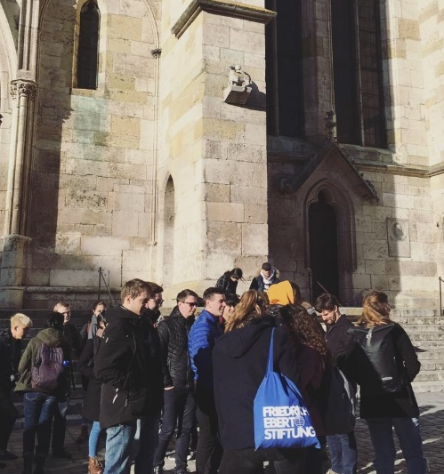
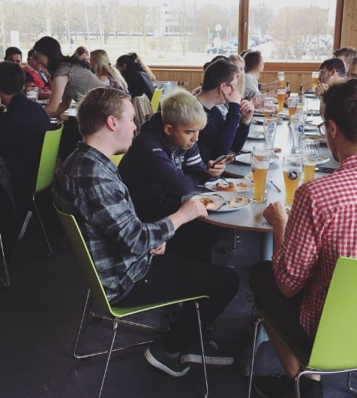
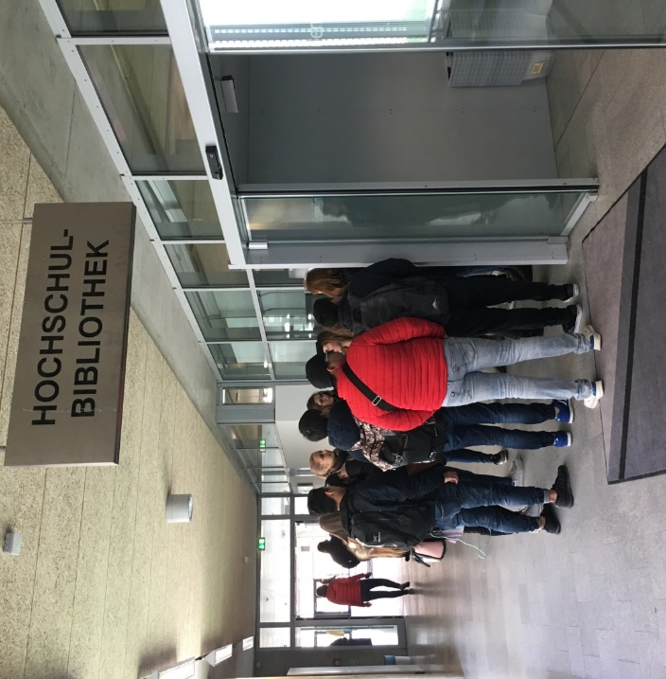
International Office – Incoming Students
Administrative Offer of IO
  Support in Mobility Online registration process
  Housing support
  Support in organization of formalities, arrival & departure
  Support in course & exam registration and with Learning Agreement
  Support in non-academic registration topics (bank, city registration, insurance, …)
  Buddy & Tutor Programme
  (Online) Office Hours & advisory service throughout the semster
  Welcome Weeks and Welcome Programme before the official semester start with lots of activities for intercultural exchange
City Tour of Regensburg
University Tour
Bavarian Culture

Slide 9



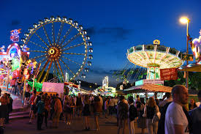




Welcome programme & semester events
Coffee Hour:
weekly coffee date for
questions and support
Excursions to
different cities on weekends
Stammtisch:
Every week in a different
bar
Regensburger Dult
(beer festival)
Guided city tour
through Regensburg
International
Workshop
with International dinner
„Weißwurstfrühstück“
Traditional Bavarian breakfast
International
Christmas party
p. 10

Slide 10
International Office – Incoming Students
Requirements for Exchange Students:
For studies in English language: level of B2 English
For studies in German language: level of B2 German
Nomination of home university’s International Office in Mobility Online system
Nomination deadlines:
  15th November (for summer semesters)
  1st May (for winter semesters)
For successful registration:
  Learning Agreement
  Copy of passport & VISA
  Registration Deadlines:
  December 1st for summer semesters
  June 1st for winter semesters
All information can be found on our OTH website (and on the flyers):
https://www.oth-regensburg.de/en/international/incoming-students/exchange.html
Current Corona measures:
2G rule in Bavaria for most of all public places, restaurants, agencies, also for OTH campus & lecures
2G= proof of valid EU-vaccination/ recovery
p. 9

Slide 11
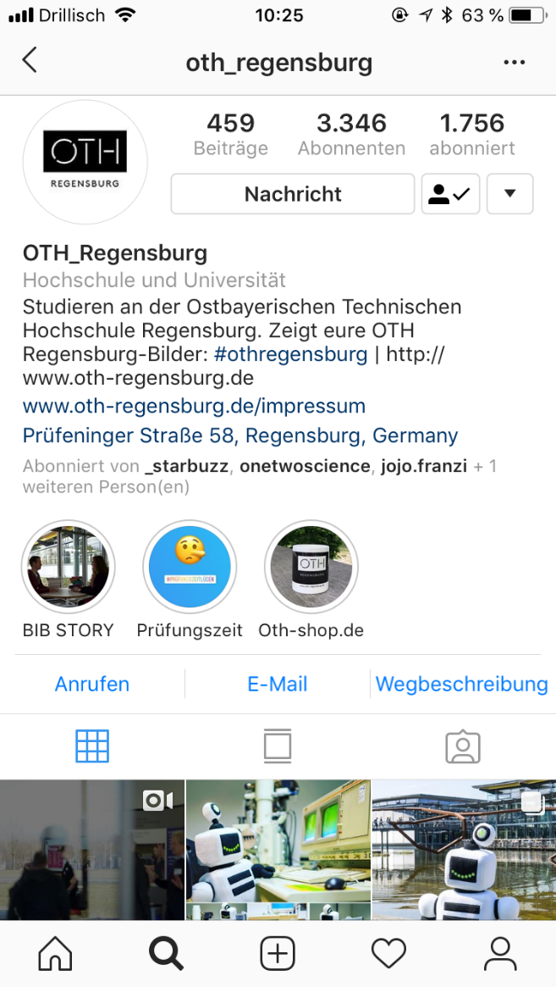





Social Media
For further informations and news:
Homepage International Office
Facebook
Instagram
Twitter
YouTube Channel
https://www.youtube.com/watch?v=LihTBNK6DKY&list=PLnvQxOLphB5L6QXf_dn0nE3Pug7w5rLUP
Contact for Incoming Exchange Students:
incoming-international@oth-regensburg.de
Instagram Feed OTH Regensburg

Slide 12
Thank you for your attention!

